Slide 1

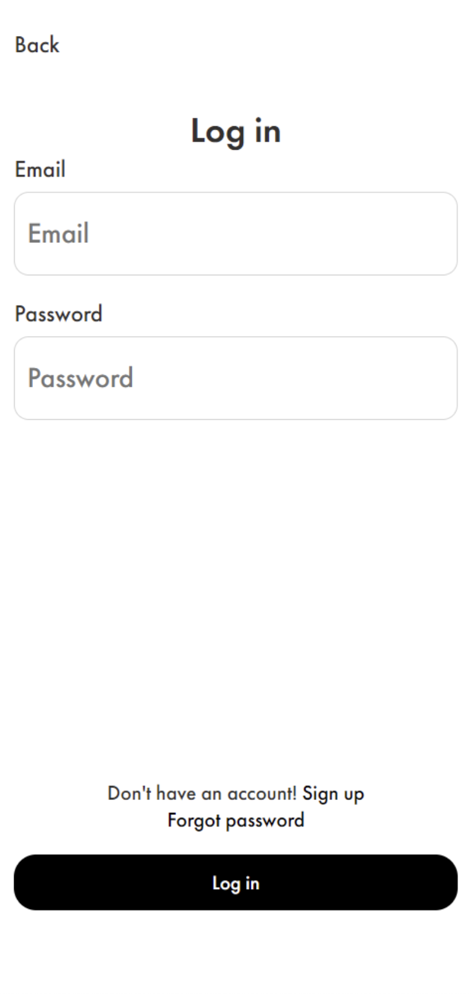

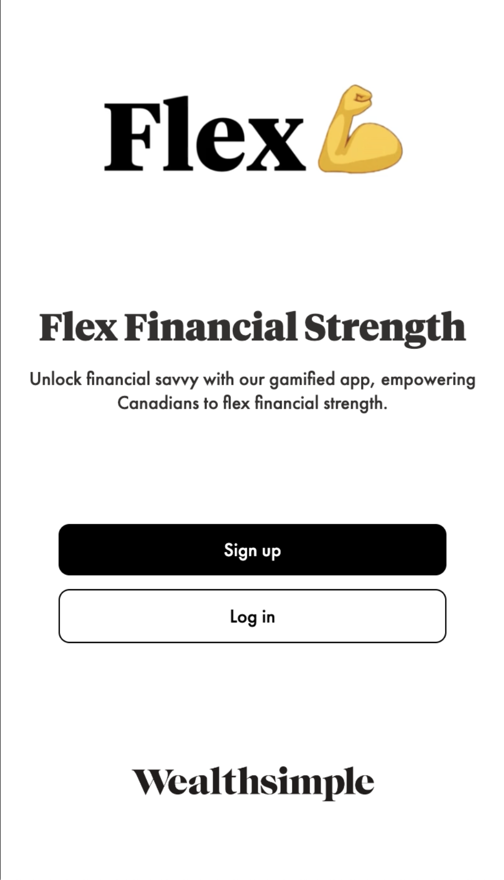

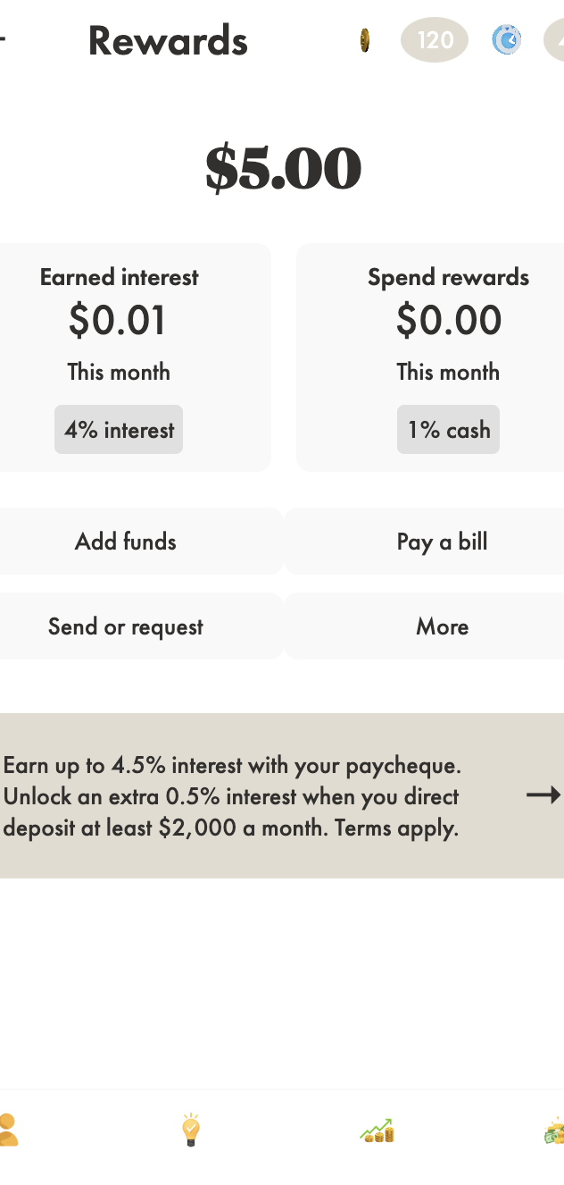
Persona
About
FAQ
Research
Flex Financial Strength
By Students: Kim, Anelya, Wei, Peishan & Sharon
Link to GitHub Repo
Get Started

Slide 2


Research
Persona
About
FAQ
The Question Posed to us
How might we help ‘s clients in Canada to improve their financial literacy and make better personal finance decisions?

Slide 3
Research
Persona
About
FAQ
Problem Statement
Secondary Research Facts
Student Loan Debt: According to Statistics Canada, the average student loan debt in Canada is over $26,000 per graduate .
Economic Uncertainty: Leads to cautious financial behavior. A report by the Financial Consumer Agency of Canada (FCAC) highlights that many Canadians are concerned about their financial future due to economic instability .
Lack of Financial Literacy: Many Canadians lack basic investment knowledge. A study by the Organisation for Economic Co-operation and Development (OECD) found that Canada ranks below average in financial literacy among its adult population, indicating a need for better financial education and resources .
Investment participation among Canadians is low due to significant financial burdens such as student loan debt, economic uncertainty, and a widespread lack of financial literacy. Source: Charles Schwab Foundation.
Insights to Action

Slide 4
Research
Persona
About
FAQ
DESIGN QUESTION
How might we enhance ‘s offerings to boost Canadians' financial literacy and investment confidence?

Slide 5
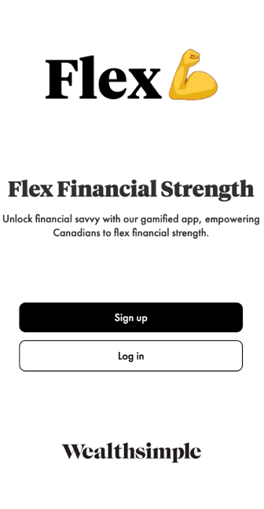


Research
Persona
About
FAQ
Opportunities for
Enhanced Personalization: Offer highly personalized financial education and advice tailored to individual user profiles.
Gamified Learning : Incorporate gamification to make financial literacy engaging and interactive.
Unique Features : AI Powered Financial Literacy Experience (FLEX) to differentiate from competitors.
Community Engagement : Leaderboard, Investing Status, Live Q&A Sessions.
Hypothesis
Integrating Flex, an AI-powered Financial Literacy Experience, will improve Canadians' financial knowledge and increase their investment participation.

Slide 6

Research
Persona
About
FAQ
Meet Alex
Age: 28
Occupation: Marketing Coordinator
Location: Toronto, Canada
Education: Bachelor's Degree in Business Administration
Income: $55,000 per year
Tech Savvy: High
Fun Fact: Has a mug that says, "World's Best Investor" 😉 (inspired by "World's Best Boss")
Goals and Motivation:
Financial Independence: Wants to be the Michael Scott of personal finance – rich and misunderstood by 40.
Debt Management: Aims to "close the deal" on student loan debt within 5 years.
Investment Knowledge: Aspires to become a financial "Assistant to the Regional Manager" – knowledgeable and confident in investing.
Pain Points and Frustrations
Student Loan Debt: Feels like Kevin with his chili – constantly spilling over payments and financial goals.
Lack of Financial Literacy: Navigating investments feels like trying to understand Creed's job description – confusing and unclear.
Time Constraints: Juggles learning about finance like Jim juggles pranks on Dwight – tricky with a busy work schedule.
Behaviours: Digital Native. Research Oriented. Cautious Investor.

Slide 7
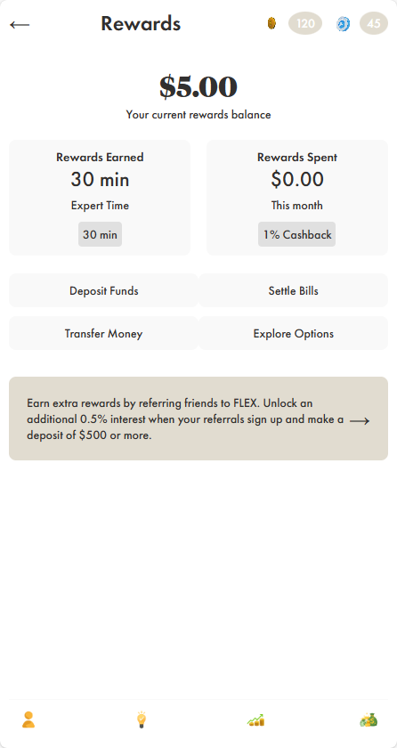
Persona
About
FAQ
Research
How FLEX Can Help Alex
Personalized Learning Paths: Educational modules tailored to Alex's goals like learning more about stocks she could possibly invest in, making investing feel less like "Dunder Mifflin Infinity" and more like "Dunder Mifflin Success.”
Interactive Tools: Budget planner, investment simulator, and debt repayment calculator to help Alex manage finances as effectively as Angela manages her cats.
Community Support: Forums and live Q&A sessions with financial experts, providing guidance like Jim's pranks – surprising, helpful, and always engaging.
Alex owns a condo with FLEX

Slide 8
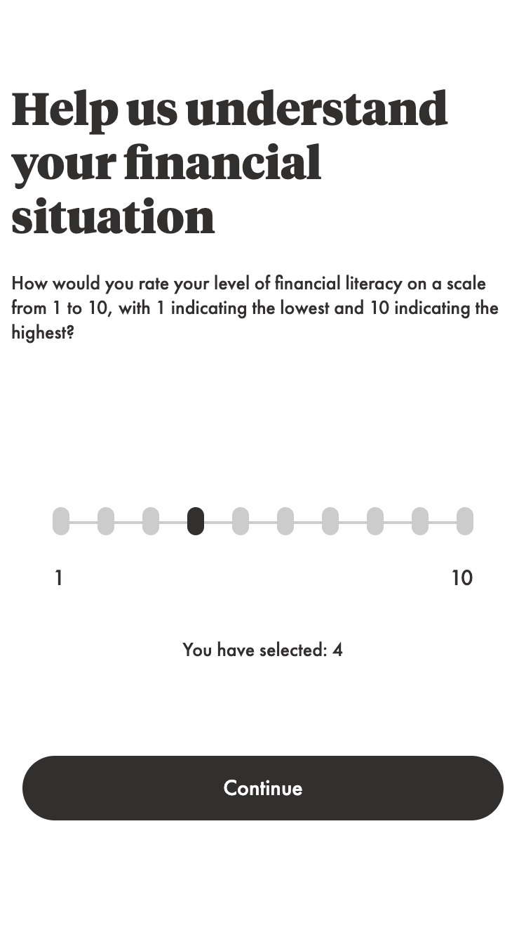
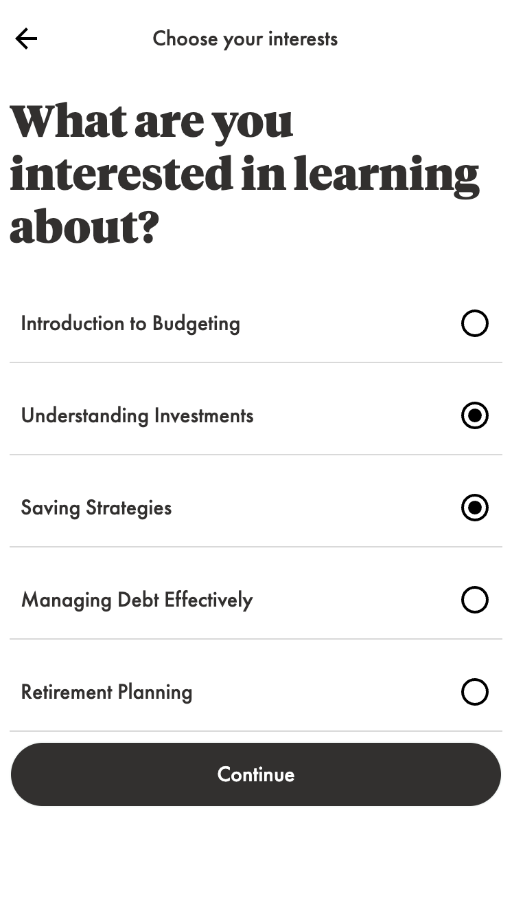
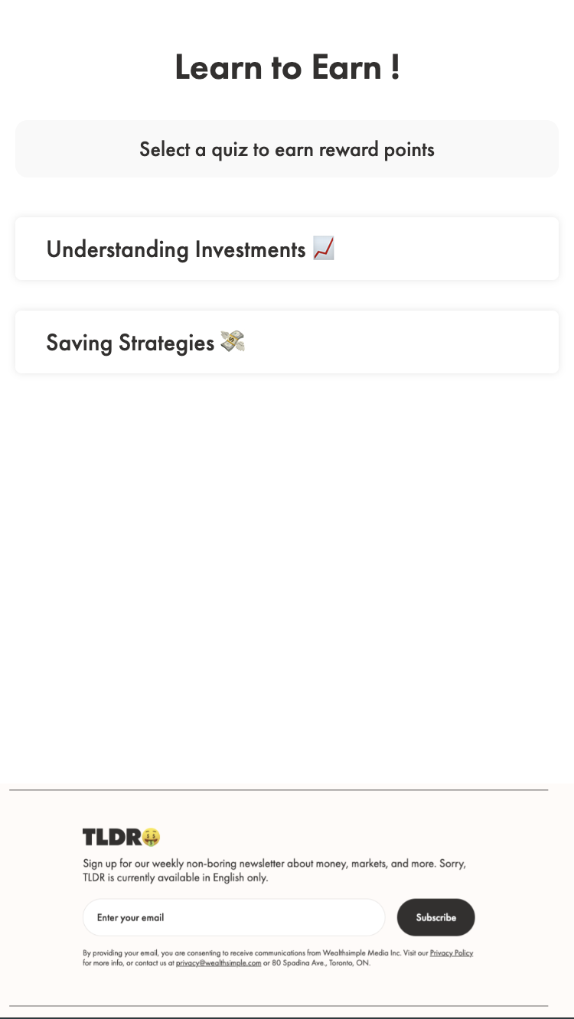
Persona
About
FAQ
Research
The Experience

Slide 9
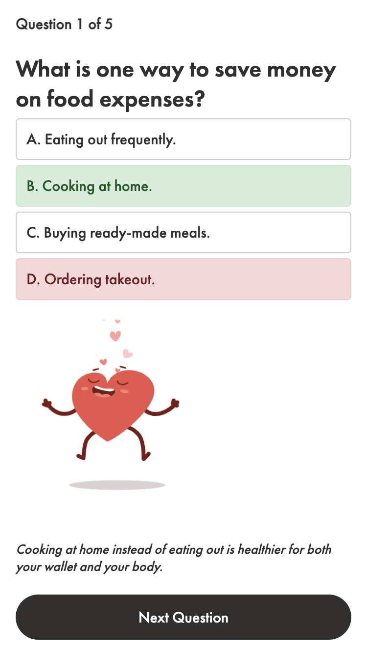
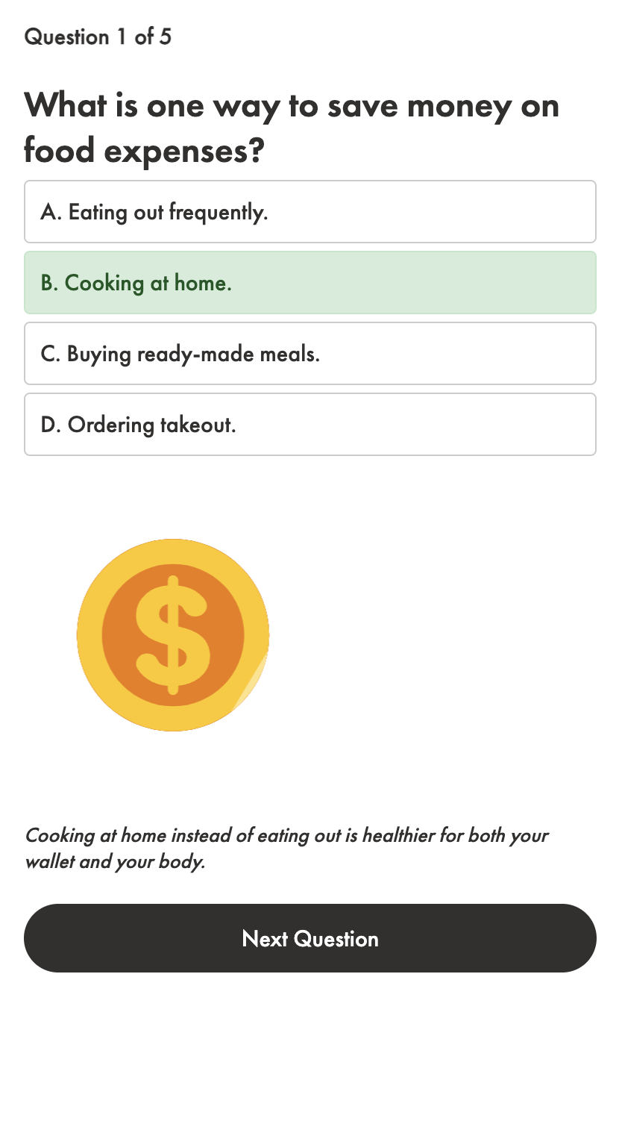
Persona
About
FAQ
Research
Where does AI fit into this App?
Personalized Financial Recommendations
Financial Literacy Enhancement
Predictive Analytics for Investment Opps

Slide 10

Research
Persona
About
FAQ
Download today
From the Students of

